Slide 1

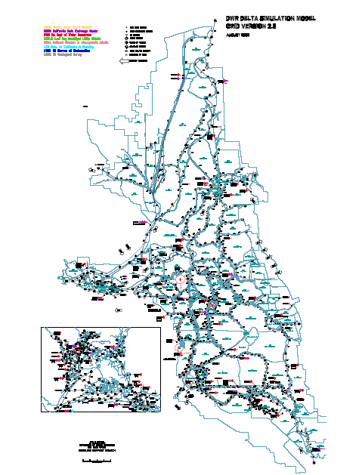
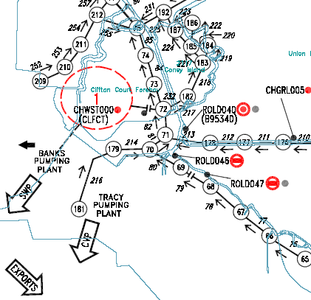
DSM2 Grid
DSM2 Cool Tip
C:\delta\dsm2_v8\documentation\DSM2_Grid2.0.pdf

Slide 2

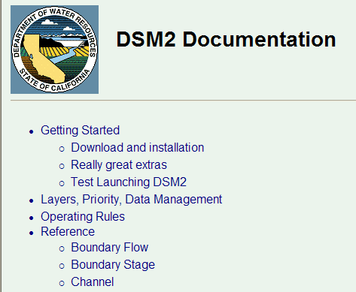
DSM2 Documentation
DSM2 Cool Tip
⇨ All Programs ⇨ DSM2v8 ⇨ DSM2_documentation

